Slide 1
EE204 Computer Architecture
Lecture 03- ISA Memory Instructions

Slide 2
Memory Addressing
How do we specify memory addresses?
This issue is independent of type of ISA (they all need to address memory)
We need to specify
(1) Operand sizes
(2) Address alignment
(3) Byte ordering for multi-byte operands
(4) Addressing Modes

Slide 3
Operand Sizes
Byte (8 bits), half-word (16 bits), word (32 bits), double word (64 bits)
An ISA may (and typically does) support multiple operand sizes
Instruction must specify the operand size
E.g. LOAD.b R1,A vs. LOAD.w R1,A
Why? Make sure there’s no “garbage data”
But usually there is a “default” size
Most commonly “word” on 32-bit machines

Slide 4
Alignment
For multi-byte memory operands
An aligned address for an n-byte operand is an address that is a multiple of n
Word-aligned: 0, 4, 8, 12, etc.
An ISA can require alignment of operands
MIPS: all memory operands must be aligned

Slide 5
More Notes about Memory Alignment
MIPS requires that all words start at byte addresses that are multiples of 4 bytes
Last hex digit of address is:
0 1 2 3
Aligned
0, 4, 8, or C_{hex}
1, 5, 9, or D_{hex}
Not
Aligned
2, 6, A, or E_{hex}
3, 7, B, or F_{hex}
Called Alignment: objects fall on address that is multiple of their size.

Slide 6
Byte Ordering (“Endianness”)
Layout of multi-byte operands in memory
Little endian (x86)
Least significant byte at lowest address in memory
Big endian (most other ISAs)
Most significant byte at lowest address in memory
Some ISAs support both byte ordering
E.g. MIPS has a Big-endian mode

Slide 7
Another view of Endianness
No, we’re not making this up.
at word address 100 (assume a 4-byte word)
long a = 11223344;
big-endian (MSB at word address) layout
100 101 102 103
100 11 22 33 44
little-endian (LSB at word address) layout
103 102 101 100
11 22 33 44 100

Slide 8
Addressing Modes
What is the location of an operand?
Three basic possibilities
Register: operand is in a register
Register number encoded in the instruction
Immediate: operand is a constant
Constant encoded in the instruction
Memory: operand is in memory
Many address modes possibilities

Slide 9
MIPS Memory
MIPS memory organized as 32-bit word
Byte Addressing
Alignment Restriction
Big Endian

Slide 10
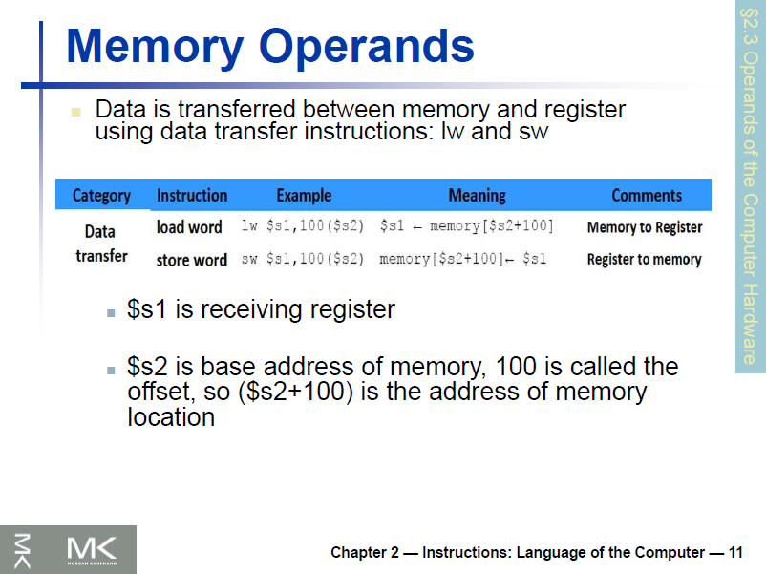

Slide 11
Load from Memory Instruction
lw register, constant (register)
Memory address = constant + register
Memory address = offset + Base Register
lw $s1, 4($s2)
C code: g = h + A[8];
MIPs code: lw $t0, 32($s3)
add $s1, $s2, $t0

Slide 12
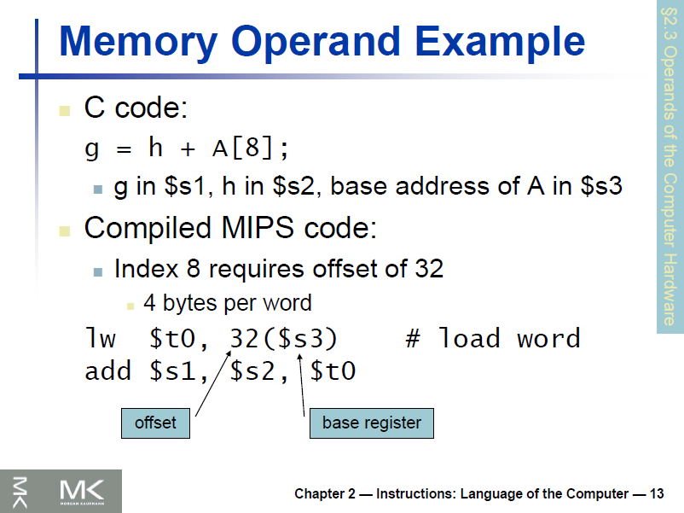

Slide 13
Store to Memory Instruction
sw register, constant (register)
Memory address = constant + register
Memory address = offset + Base Register
sw $s1, 4($s2)
C code: A[12] = h + A[8];
MIPs code: lw $t0, 32($s3)
add $t0, $s2, $t0
sw $t0, 48($s3)

Slide 14
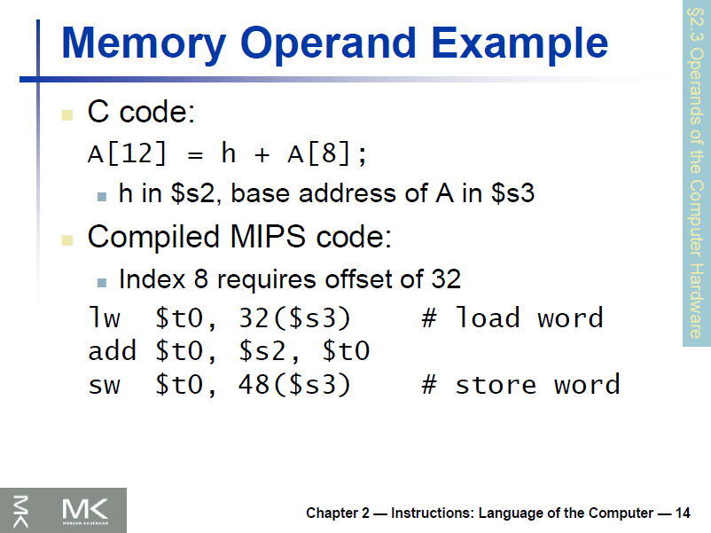

Slide 15
Load Instruction
Load/Store Instruction Format (I format): lw $t0, 24($s2)
op rs rt 16 bit offset
Memory
24₁₀ + $s2 =
0xf f f f f f f f
. . . 0001 1000
+ . . . 1001 0100
. . . 1010 1100 =
0x120040ac
$t0
0x120040ac
$s2
0x12004094
0x0000000c
0x00000008
0x00000004
0x00000000
data
word address (hex)
Notes:
destination address no longer in the rd field - now in the rt field
offset limited to 16 bits - so can’t get to every location in memory (with a fixed base address)

Slide 16
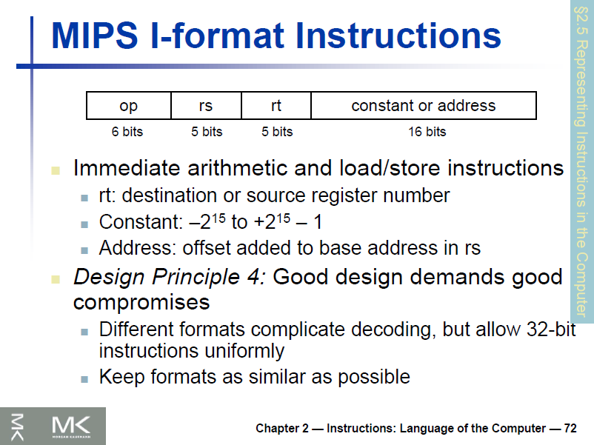

Slide 17
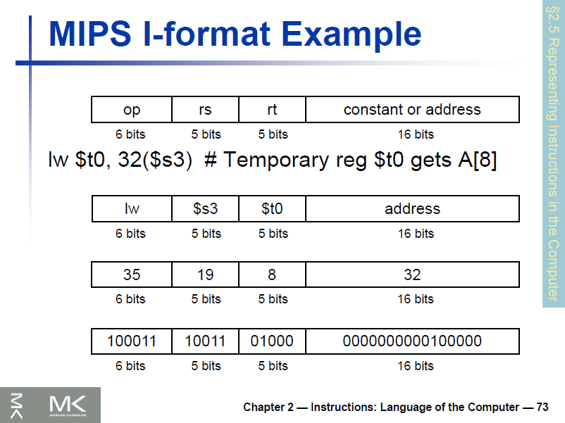

Slide 18
Variable Array Index
C Code: g = h + A[i];
g, h, i variables in registers $s1, $s2, $s4
Base address in register $s3
MIPS Code: add $t1, $s4, $s4
add $t1, $t1, $t1
add $t1, $t1, $s3
lw $t0, 0($t1)
add $s1, $s2, $t0

Slide 19
Pointers v. Values
Key Concept: A register can hold any 32-bit value. That value can be a (signed) int, an unsigned int, a pointer (memory address), and so on
If you write add $t2,$t1,$t0 then $t0 and $t1 better contain values
If you write lw $t2,0($t0) then $t0 better contain a pointer
Don’t mix these up!

Slide 20
Instruction Format
Instruction | Format | op | rs | rt | rd | shamt | funct
add | R | 0 | reg | reg | reg | 0 | 32
sub | R | 0 | reg | reg | reg | 0 | 34
lw | I | 35 | reg | reg | address
sw | I | 43 | reg | reg | address

Slide 21
Instruction Format
A[300] = h + A[300]; $t1=A, $s2=h
lw $t0, 1200($t1)
add $t0, $s2, $t0
sw $t0, 1200($t1)
op | rs | rt | rd | shamt | funct
100011 | 01001 | 01000 | 0000 0100 1011 0000
000000 | 10010 | 01000 | 01000 | 00000 | 100000
101011 | 01001 | 01000 | 0000 0100 1011 0000

